Slide 1
Meeting 17.06.2026
Update meeting with Parsa

Slide 2
Chapter 1: Is GMP/SMART sample agnostic or point sampling strategy makes a noticeable change in predictions and accuracy

Slide 3
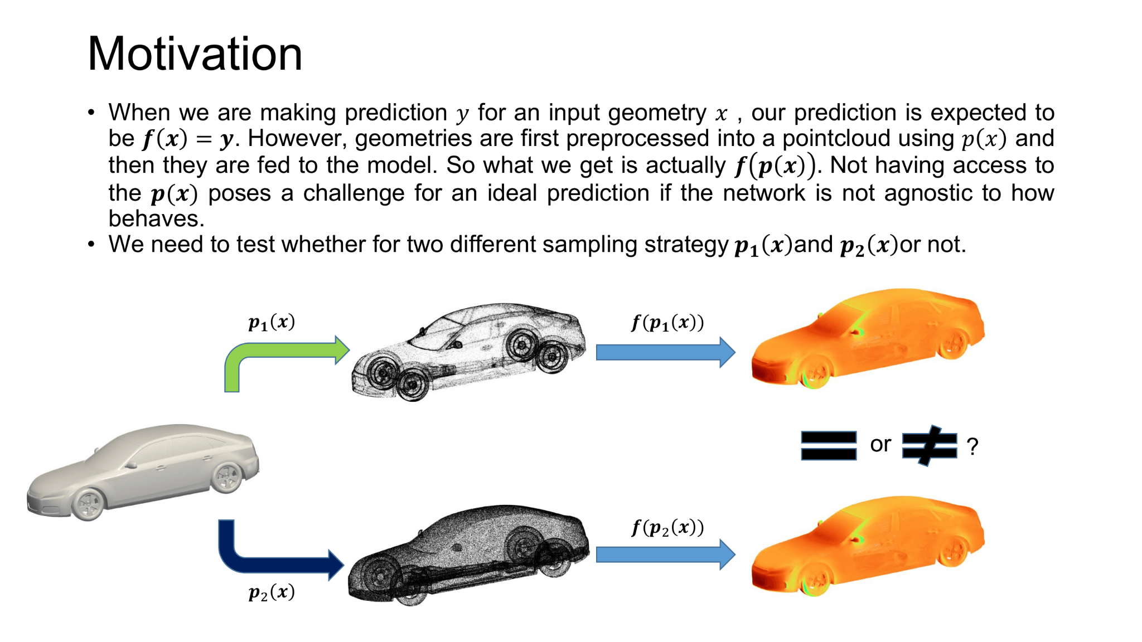

Slide 4
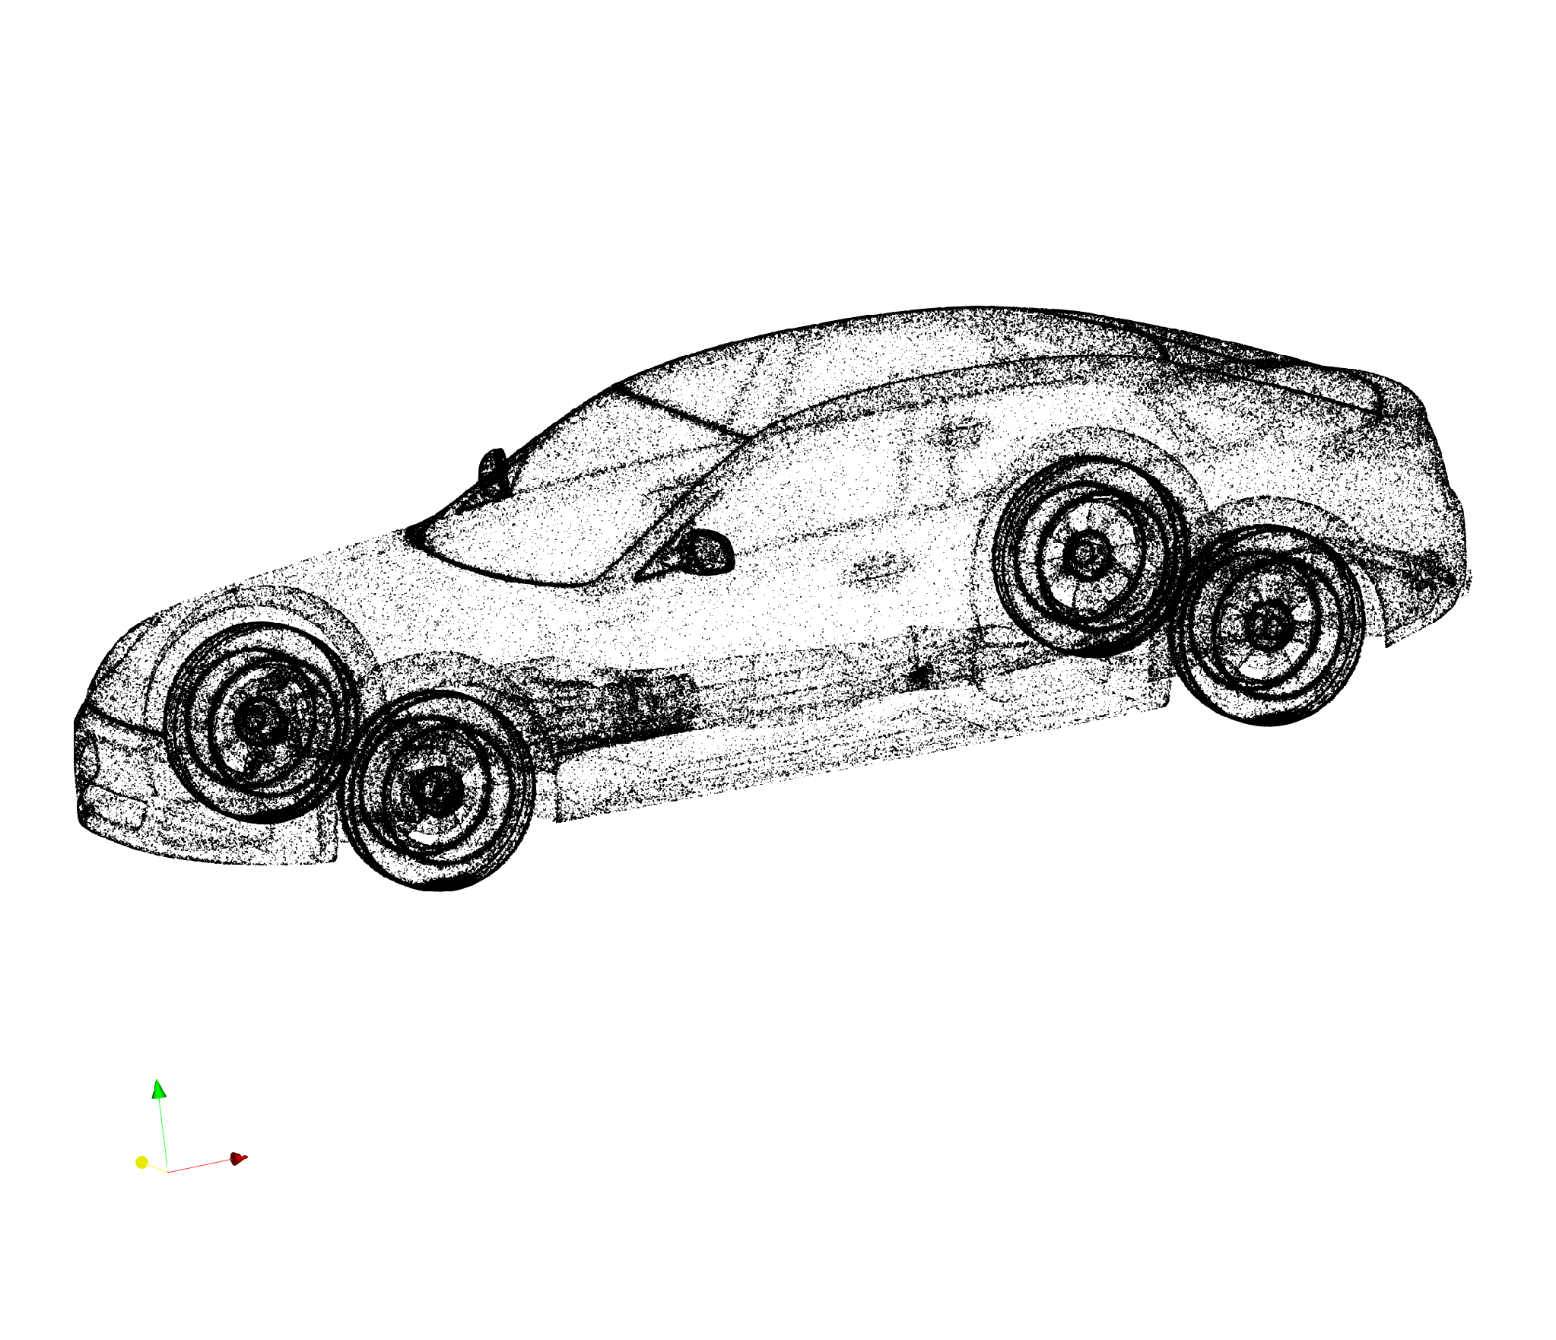
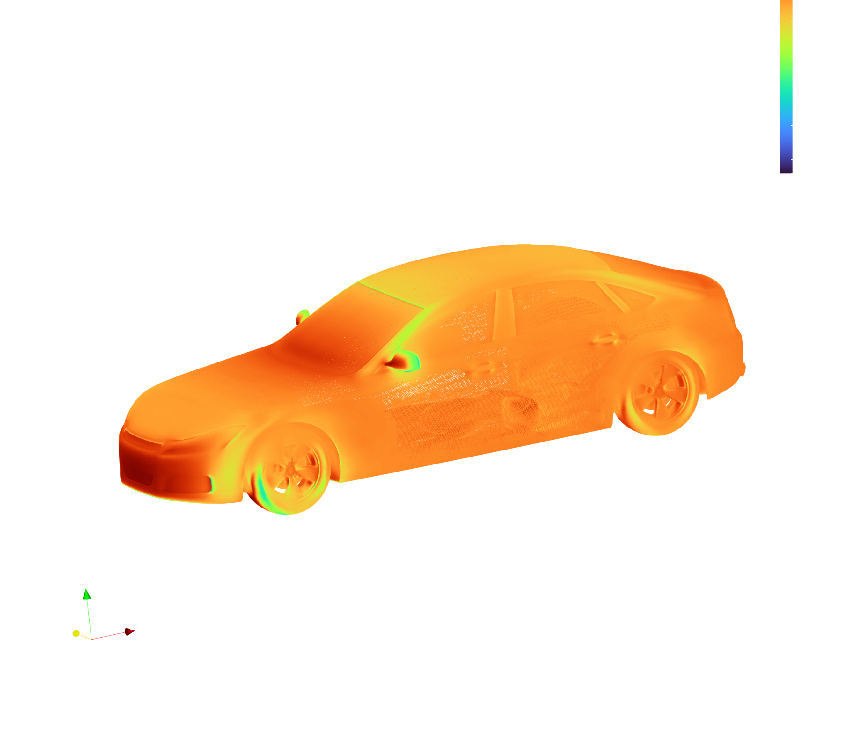
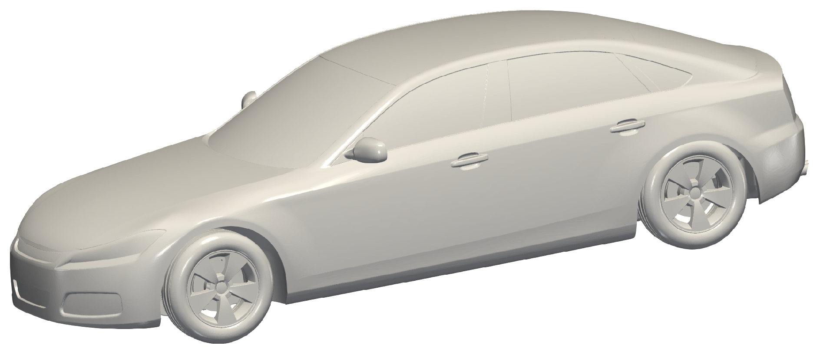
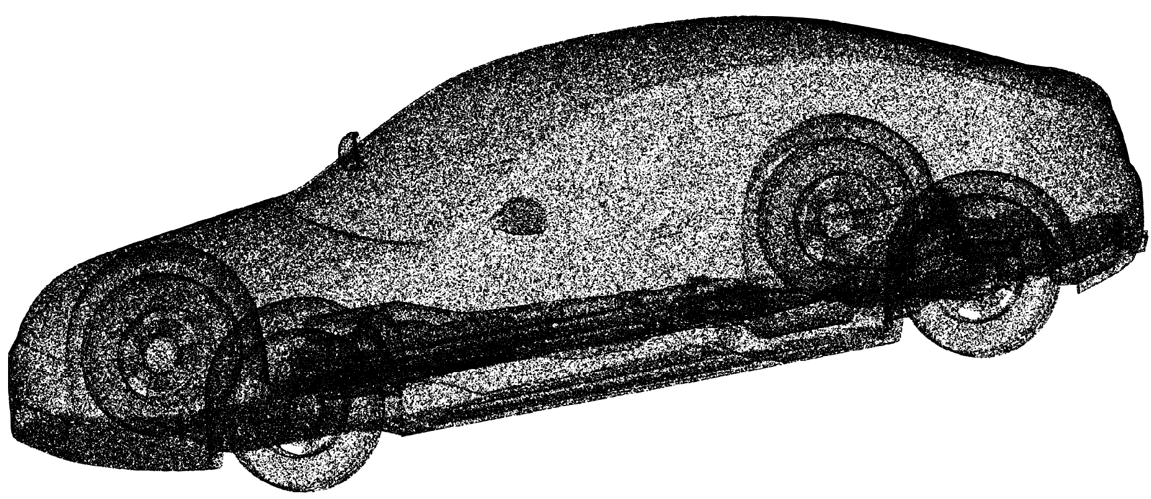
Motivation
When we are making prediction y for an input geometry , our prediction is expected to be . However geometries are first preprocessed into a pointcloud and then they are fed to the model. So what we get is actually . Not having access to the poses a challenge for an ideal prediction if the network is not agnostic to how behaves. We need to test whether for two different sampling strategy or not.
or
?

Slide 5
Testing GMP (Geometry pretrained + 500 DrivAerML Physics trained)
Neglecting the CFD results at this slide, we just focus on seeing the GMP predictions on the sampling strategy that came with DrivAerML vs. The sampling strategy from the Audi (using their own CAD tool to re-mesh the low-quality stl file)
DrivAerML had access to the high quality stl but published a compressed low triangle version. For this reason we had to re-mesh the stl to be able to run it in CFD. This re-meshing created a difference in the distribution of vertices. For example both of these show 0.5M vertices, while the distribution is clearly different:
Audi Meshing Strategy
Equivelebt DrivAerML Sample

Slide 6
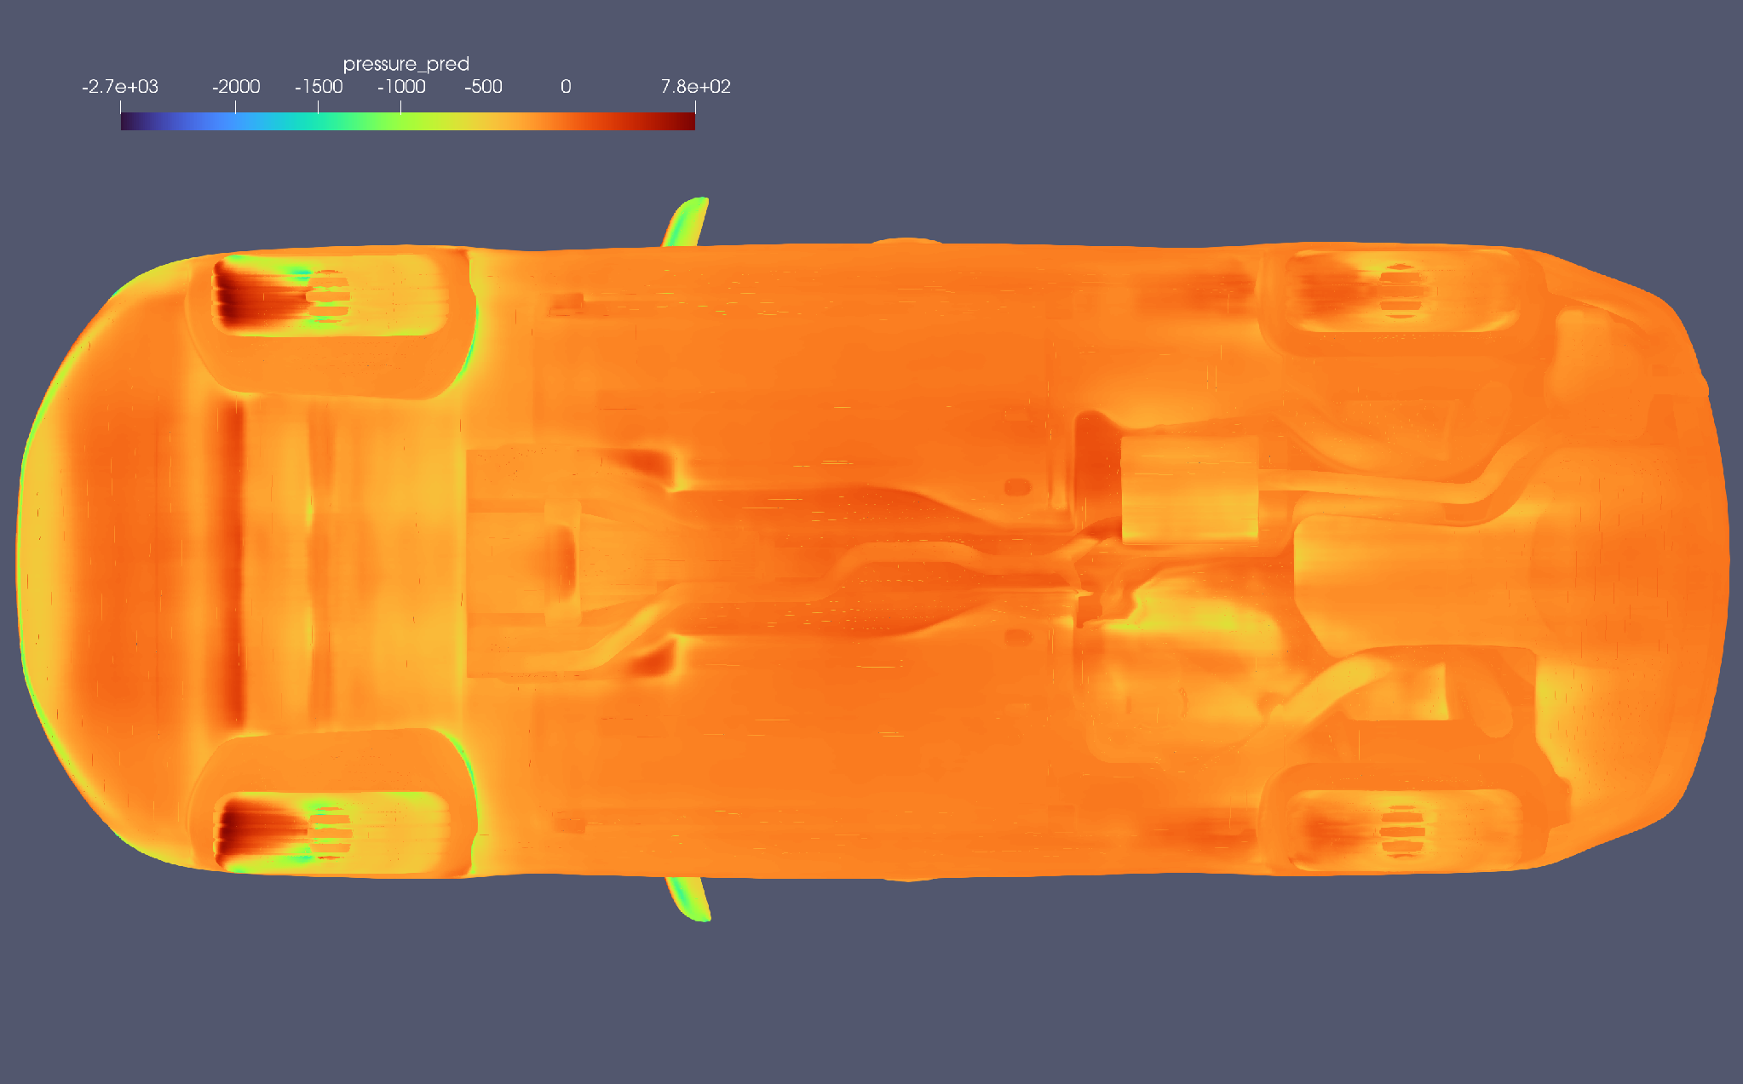
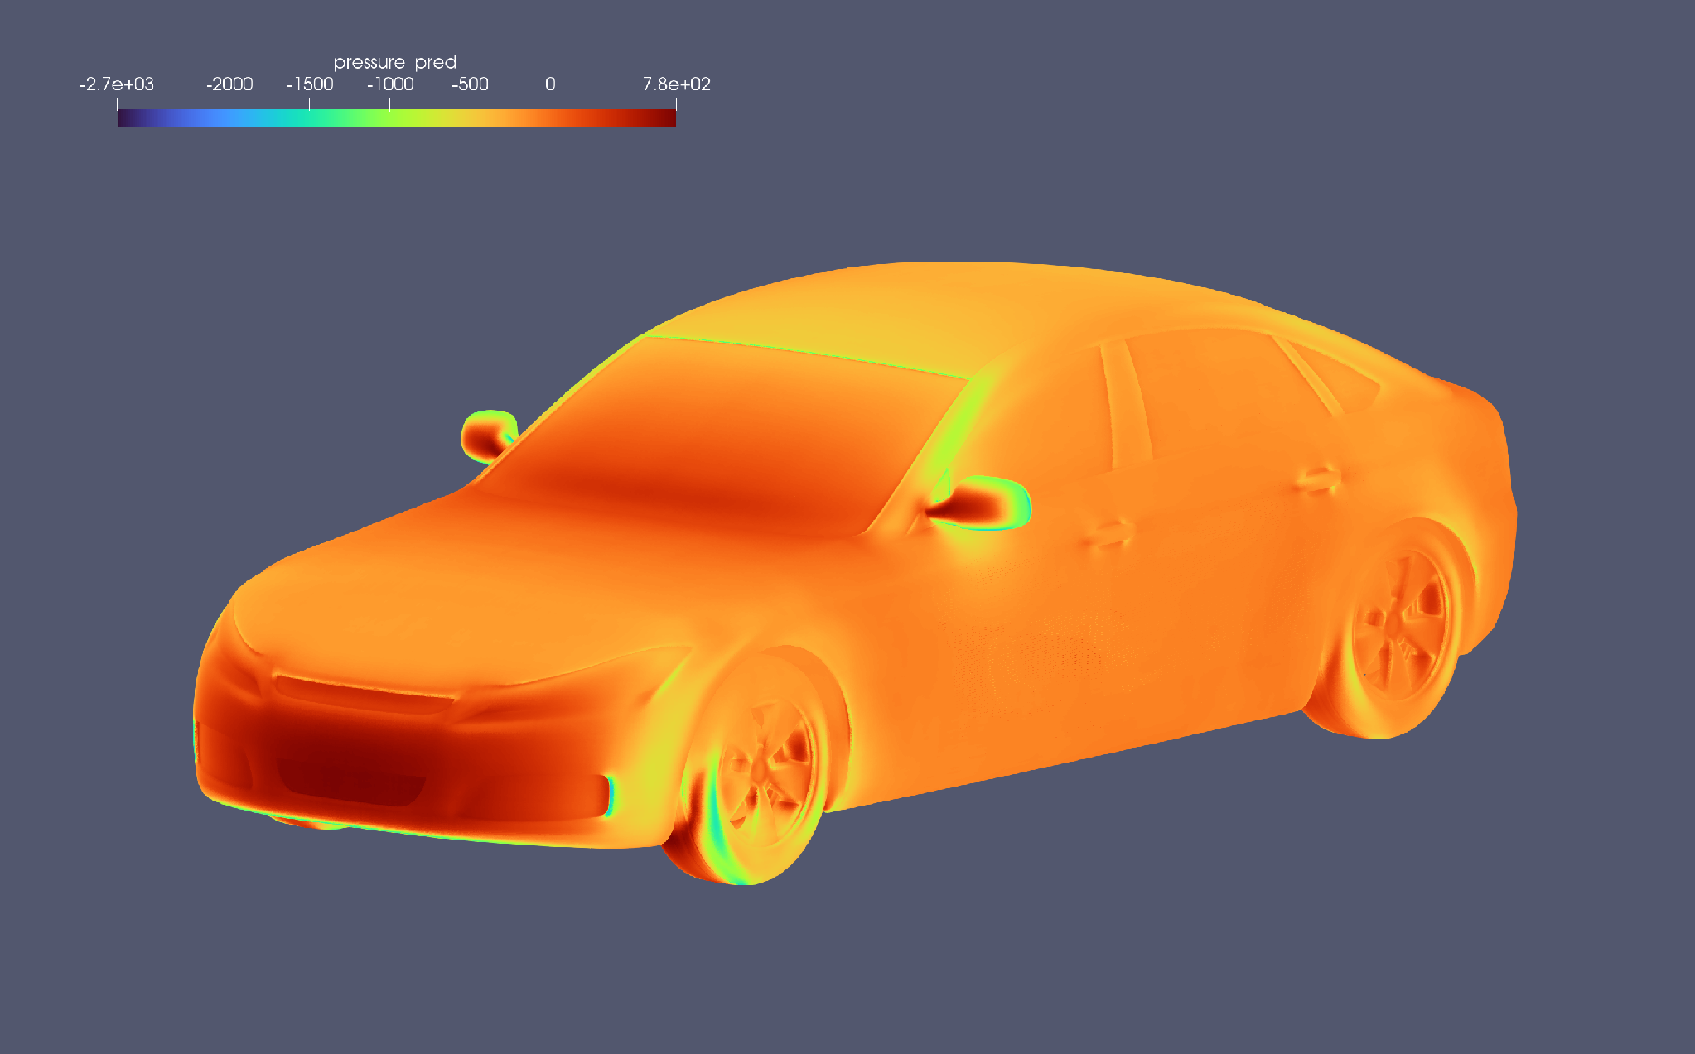
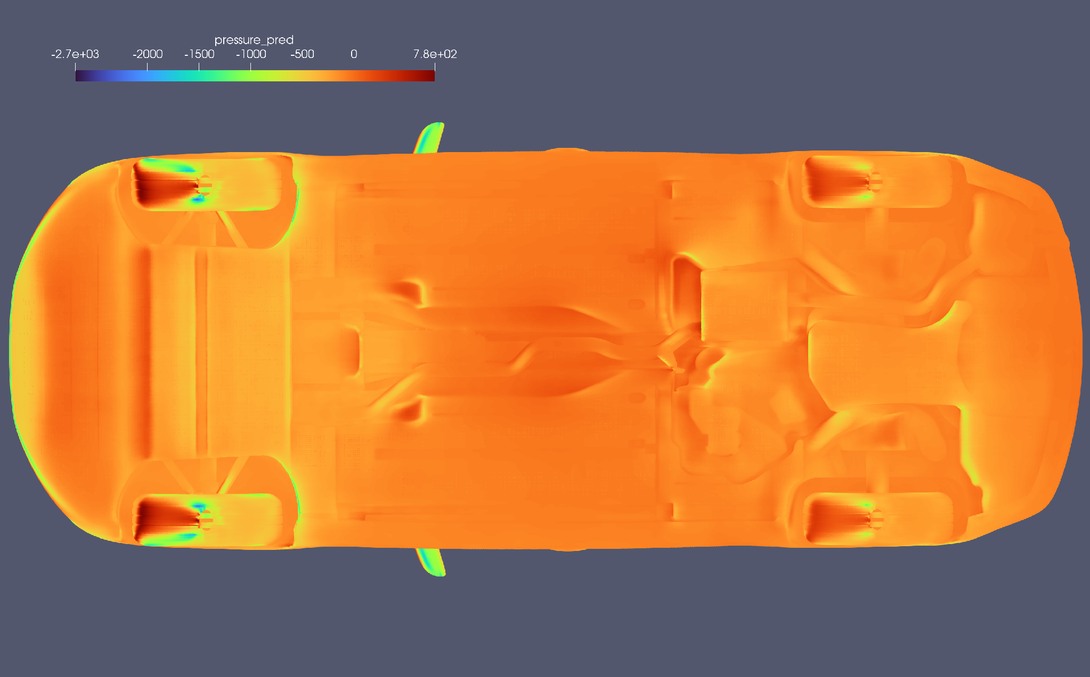
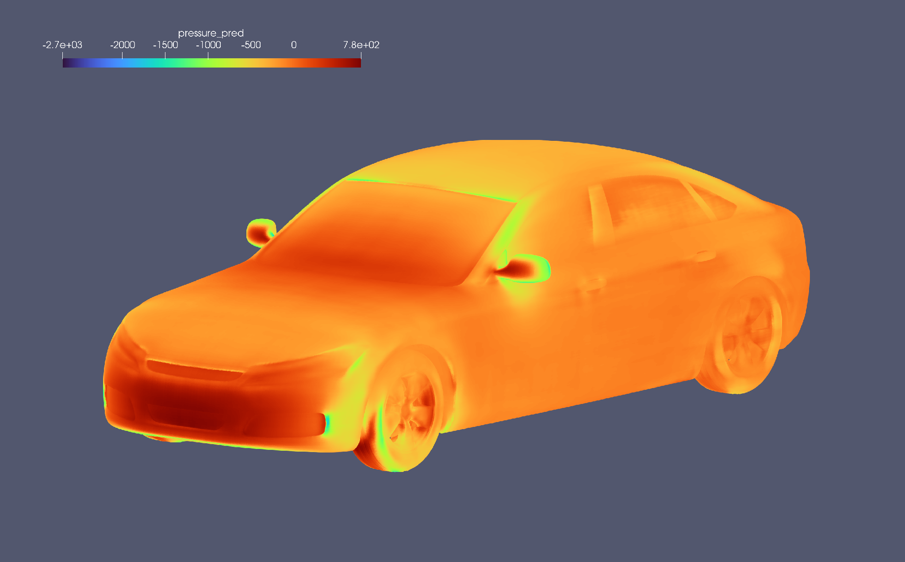
Testing GMP (Geometry pretrained + 500 DrivAerML Physics trained) - Predictions
DrivAerML
Sampling As Input
Audi
Sampling As Input

Slide 7
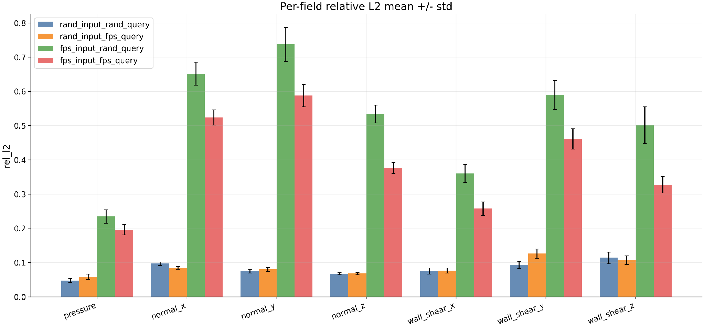
Four Experiments to see the effect of distribution in both input and query on error On GMP that has been trained on random sub-sampling for both input and query The point distribution here is from DrivAerML, random sub-sampling preserves it while FPS shifts it

Slide 8
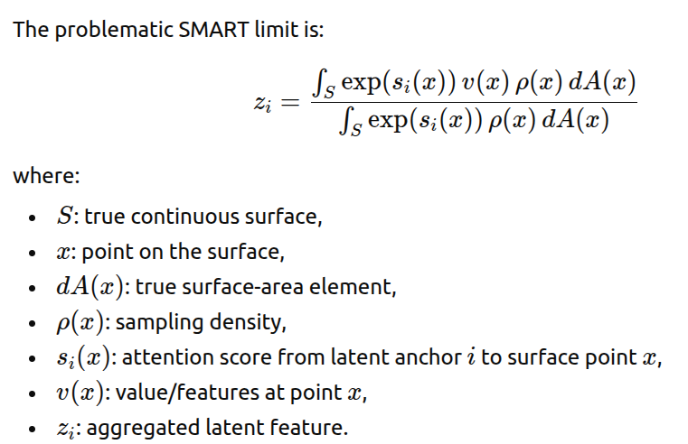
The mathematics behind the issue
In an anchored attention-based encoder, we aggregate the features of the input point cloud using the below mentioned equation. This features can be the position embedding or extra attributes like surface normals:

Slide 9

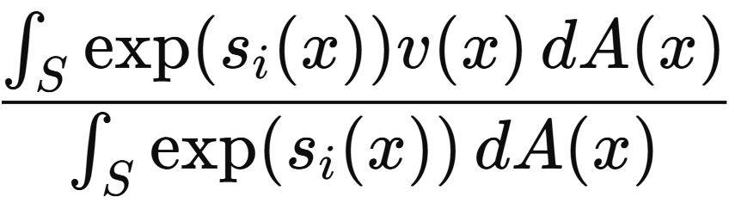
The mathematics behind the solution

Slide 10
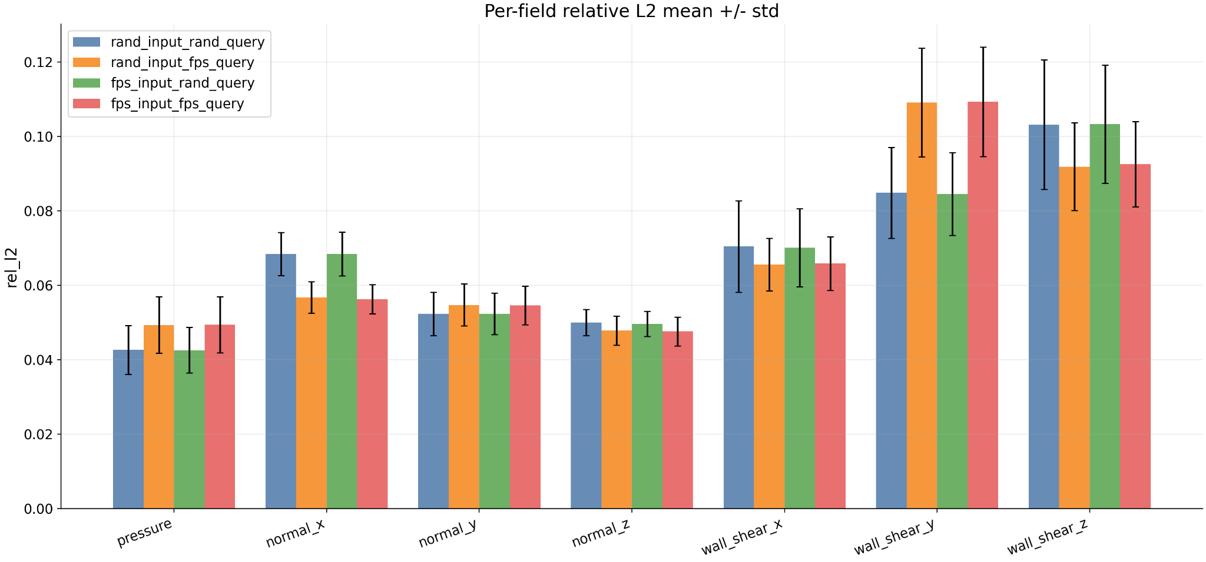
Result after the solution (on 25 test subsample)
Important: the range was upto 0.8 before

Slide 11
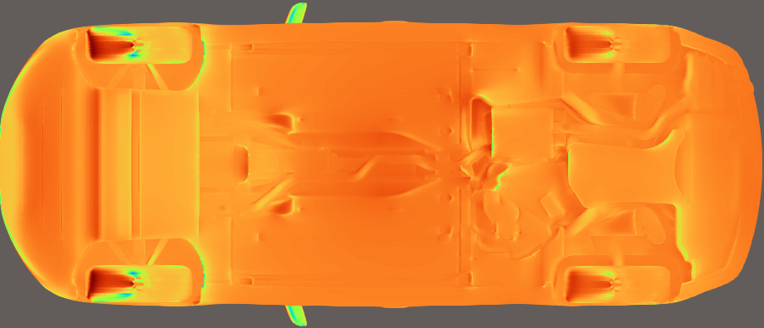
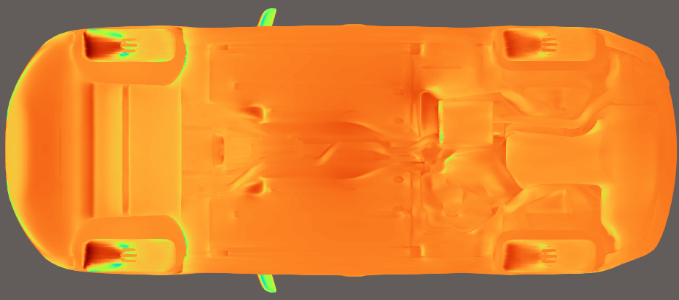
GMP output comparison after density correction
Before
DrivAerML
Sampling As Input
After
Audi
Sampling As Input

Slide 12
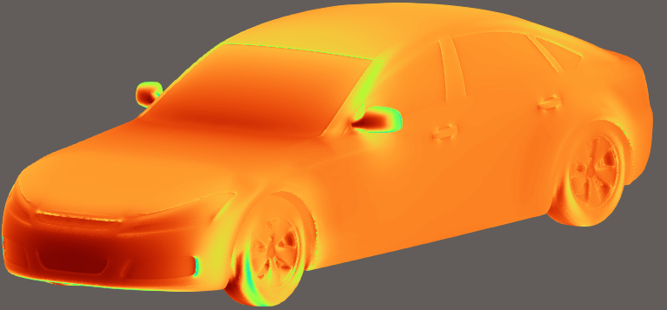
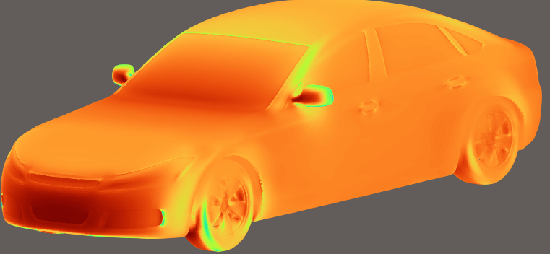
GMP output comparison after density correction
Before
After
DrivAerML
Sampling As Input
Audi
Sampling As Input

Slide 13
Chapter 2: Trying further geometries with Audi CFD and comparing the prediction of GMP with this ground truth

Slide 14
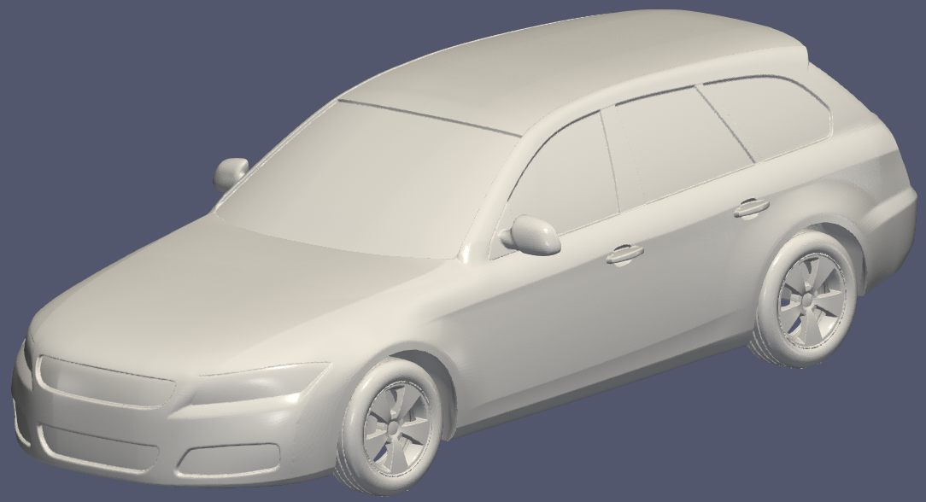
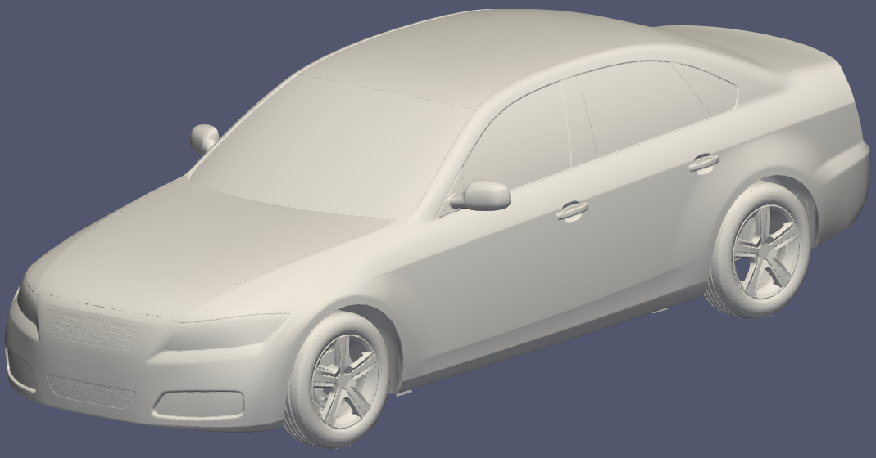
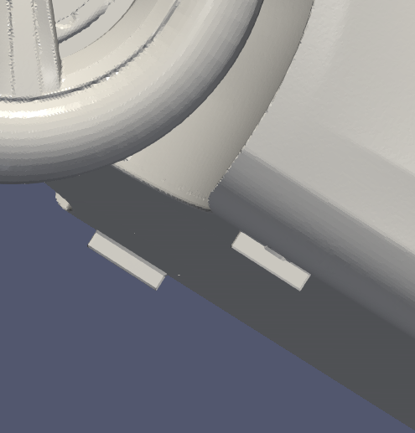
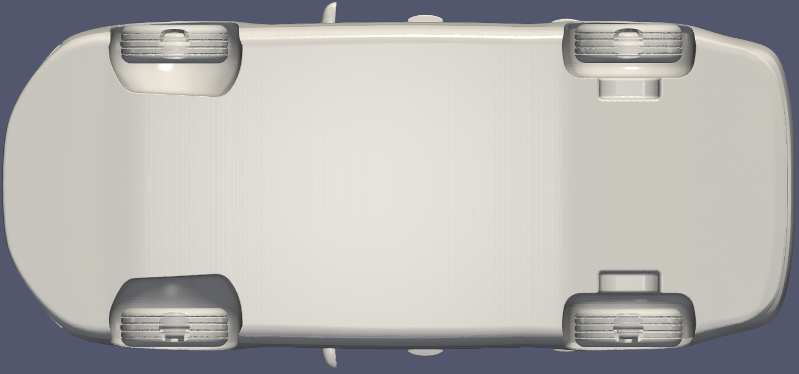
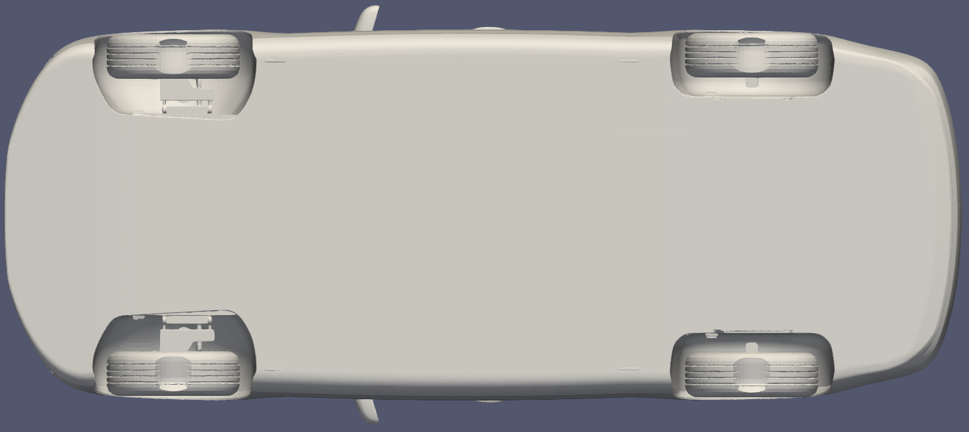
Experimented Geometries

Slide 15

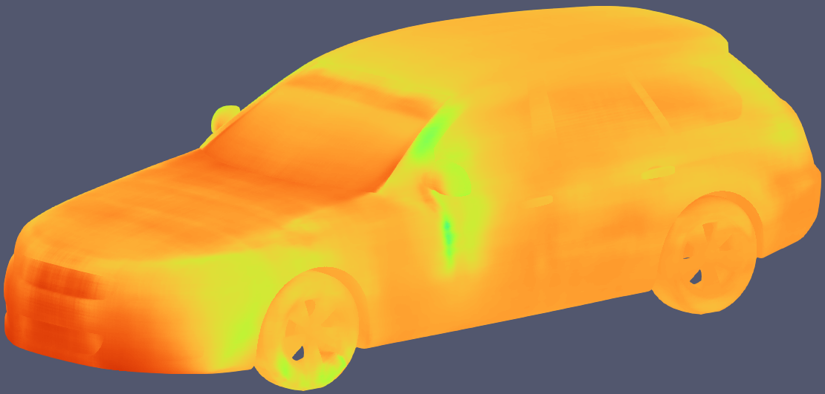
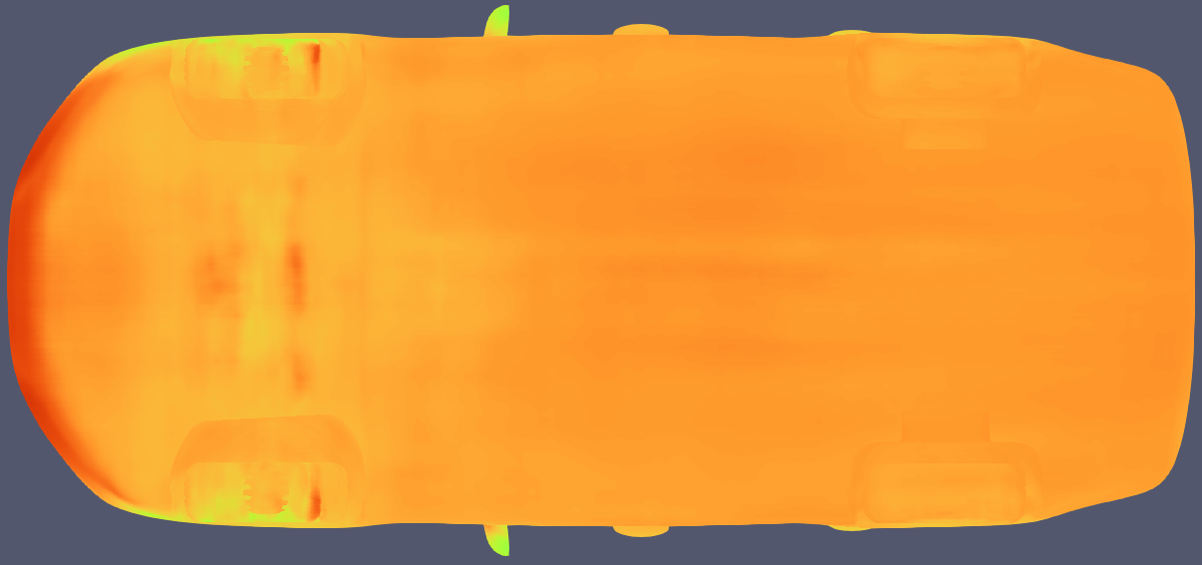
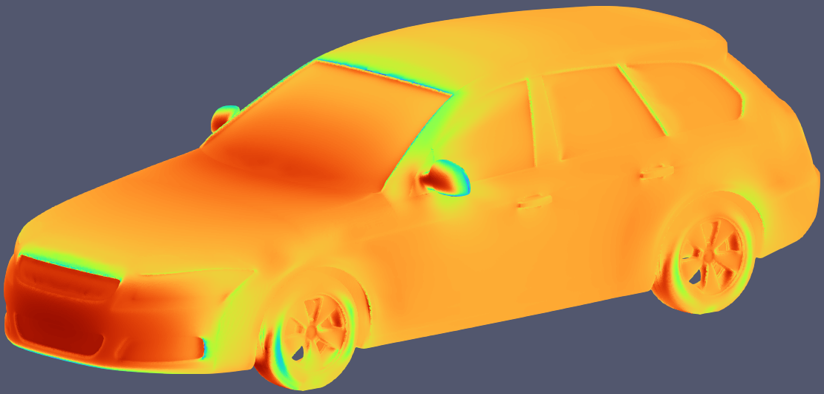
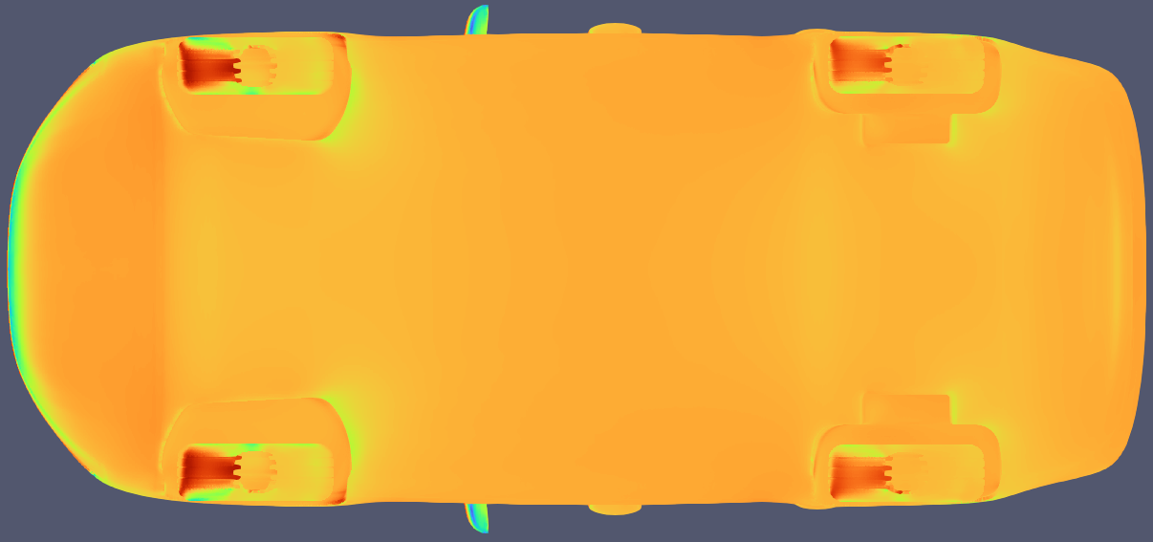
Audi CFD results vs GMP prediction - Estate-back
GMP
Audi CFD

Slide 16
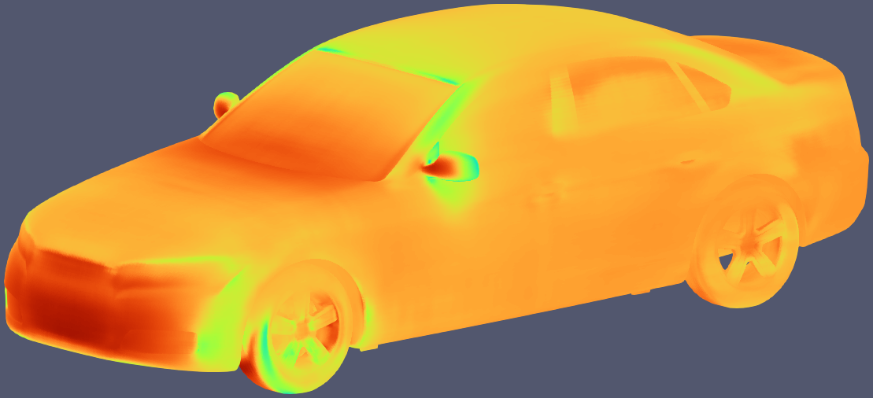
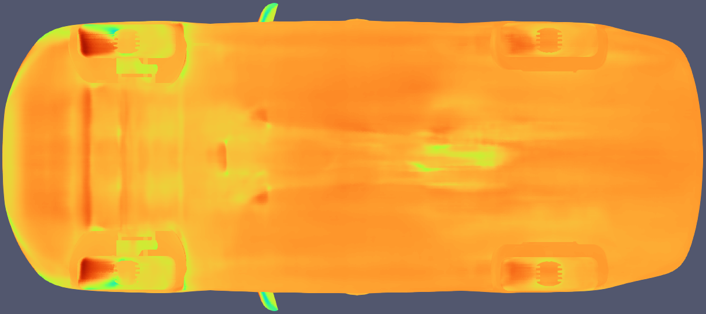
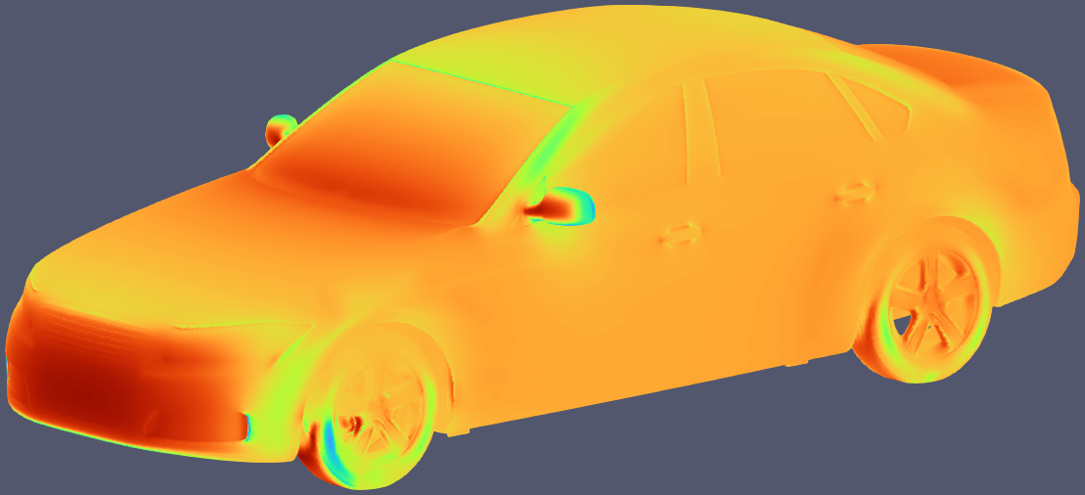
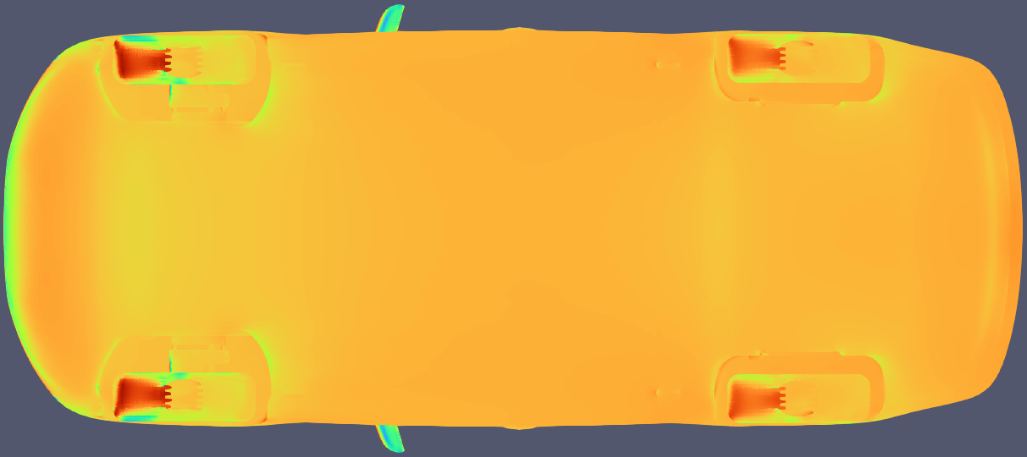
Audi CFD results vs GMP prediction – Notchback
GMP
Audi CFD

Slide 17
Chapter 3: Chapter 1 + Chapter 2

Slide 18
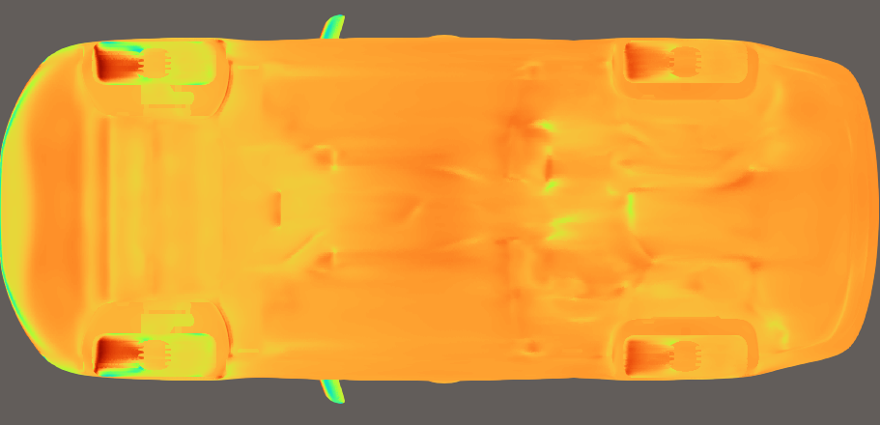
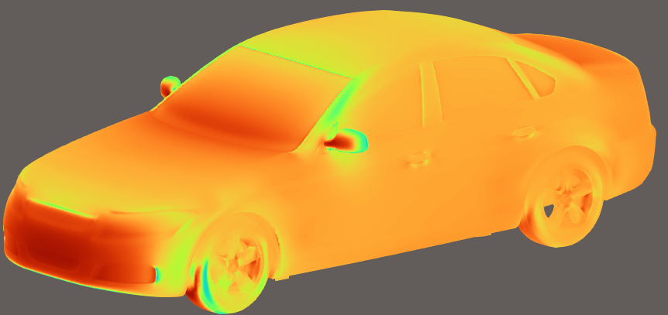
GMP + correction
GMP
Audi CFD

Slide 19
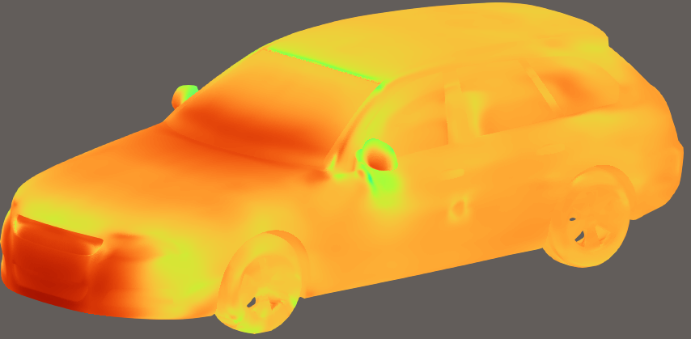
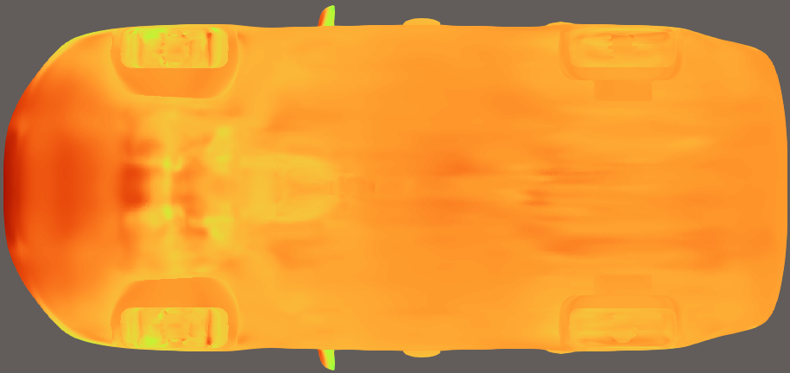
GMP + correction
GMP
Audi CFD

